Slide 1
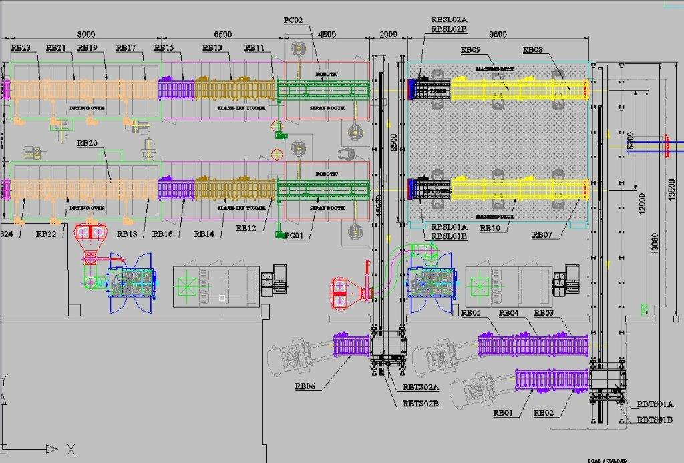
Zone Control Concept
< Legend >
:LightCurtain :Operation box (Activate with Auto mode)
: HMI
: E-Stop :SIGNAL Tower
: Safety Limit Switch
: Control Station Box
Operator Box ( 3,6) :- 200X200X120
Operator Box ( 1,2,4,5) :- 150X150X120
CS1:- 150X150X120
HMI: 520X600X191
2
1
3
4
3
2
1
7
5
6
5
4
8
6
9
10
1
1
CS1
2
1
2
IPC
Zone 2
Zone 1
1
2012/6/2

Slide 2
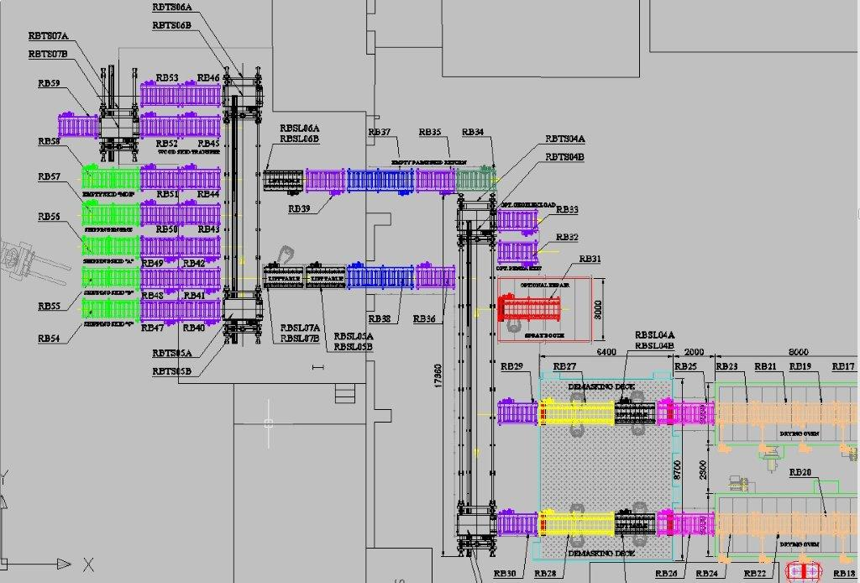
Zone Control Concept
< Legend >
:LightCurtain :Operation box (Activate with Auto mode)
: HMI
: E-Stop :SIGNAL Tower
: Safety Limit Switch
Operator Box ( 7,9) :- 200X200X120
Operator Box ( 8,10,11) :- 150X150X120
CS2,3:- 150X150X120
Zone 3
3
3
CS2
11
4
CS3
4
8
7
Zone 4
10
9
2
2012/6/2

Slide 3
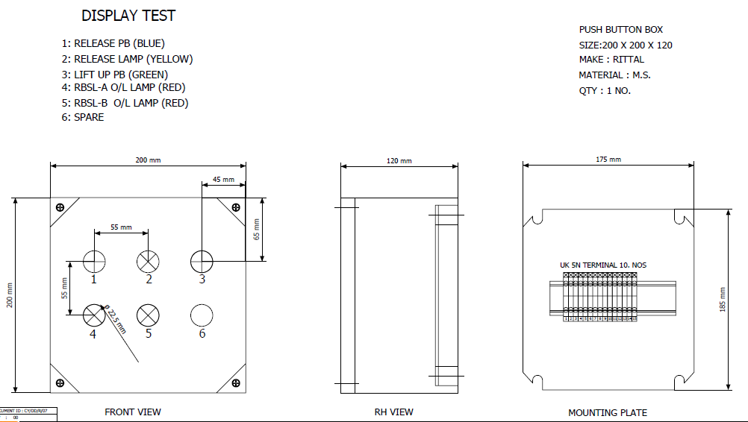
CS-3,6,7,9

Slide 4
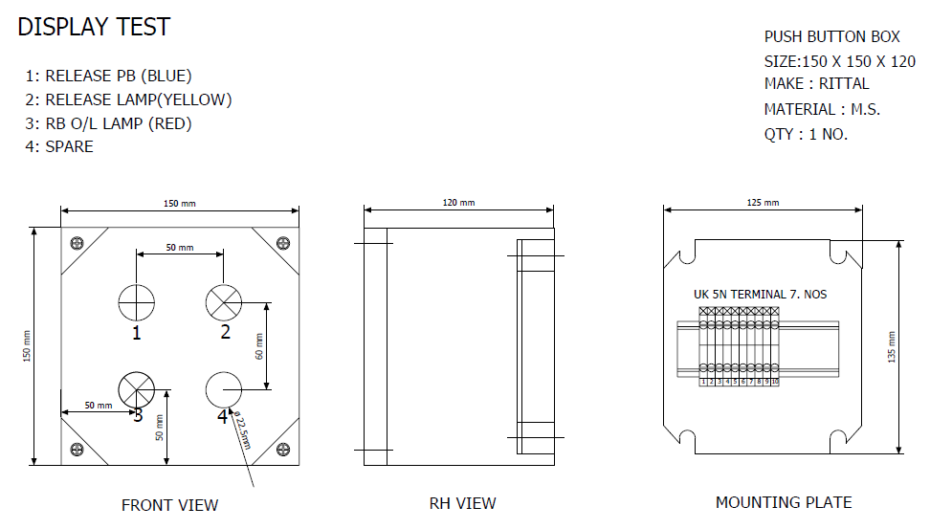
CS-1,2,4,5,8,10,11

